Slide 1
One hidden layer
Neural Network
Neural Network
Representation
Notes:
We will start with one hidden layer.

Slide 2


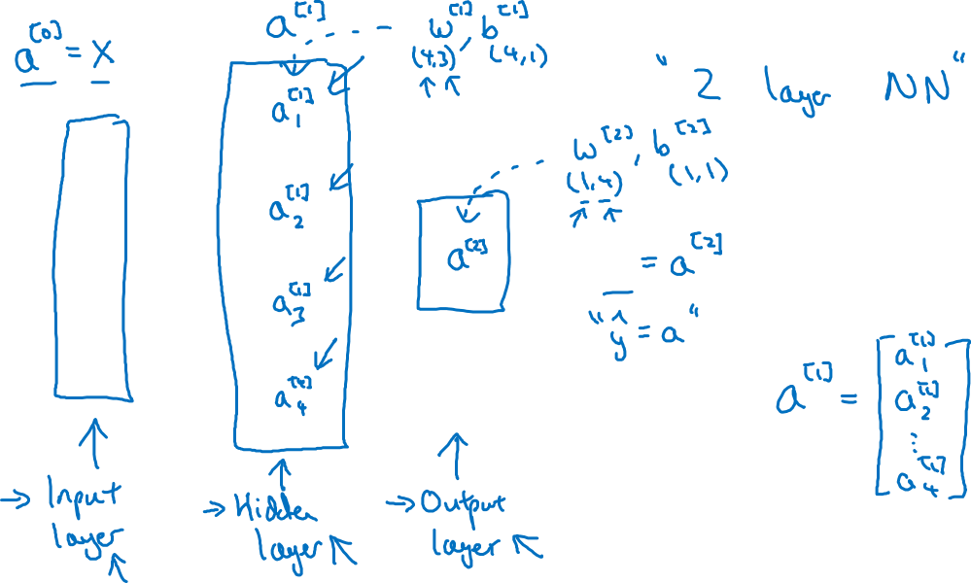


Neural Network Representation
$$x_{1}$$
$$x_{2}$$
$$\hat{y}$$
$$x_{3}$$

Slide 3
One hidden layer
Neural Network
Computing a
Neural Network’s
Output

Slide 4











Neural Network Representation
$$x_{1}$$
$$x_{1}$$
$$x_{2}$$
$$σ(z)$$
$$a=\hat{y}$$
$$x_{2}$$
$$\hat{y}$$
$$w^{T}x+b$$
$$z$$
$$a$$
$$x_{3}$$
$$x_{3}$$
$$z=w^{T}x+b$$
$$a=σ(z)$$

Slide 5

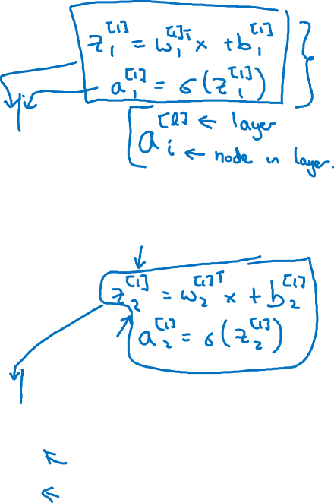





Neural Network Representation
$$x_{1}$$
$$x_{1}$$
$$x_{2}$$
$$σ(z)$$
$$a=\hat{y}$$
$$x_{2}$$
$$\hat{y}$$
$$w^{T}x+b$$
$$z$$
$$a$$
$$x_{3}$$
$$x_{3}$$
$$z=w^{T}x+b$$
$$x_{1}$$
$$a=σ(z)$$
$$x_{2}$$
$$\hat{y}$$
$$x_{3}$$

Slide 6

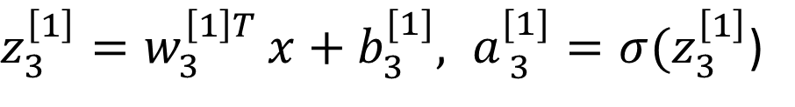


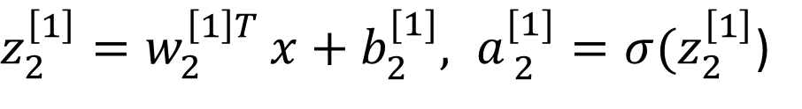
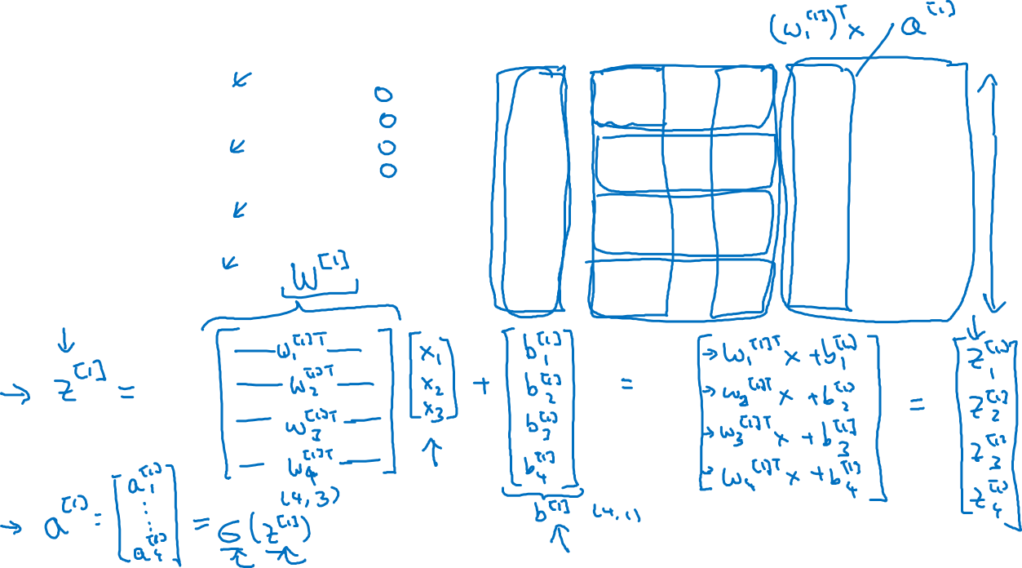

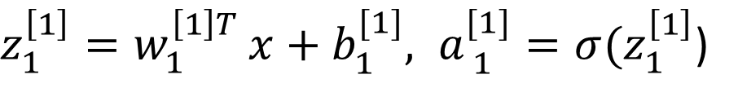




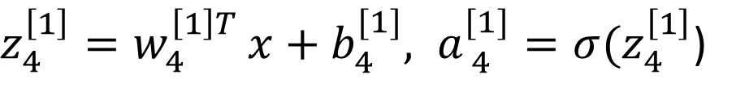
Neural Network Representation
$$a_{1}^{\left[1\right]}$$
$z_{1}^{\left[1\right]}=w_{1}^{{\left[1\right]T}^{ }}x+b_{1}^{[1]}, a_{ 1}^{[1]}=σ(z_{1}^{\left[1\right]}$)
$$x_{1}$$
$$a_{2}^{\left[1\right]}$$
$z_{2}^{\left[1\right]}=w_{2}^{{\left[1\right]T}^{ }}x+b_{2}^{[1]}, a_{ 2}^{[1]}=σ(z_{2}^{\left[1\right]}$)
$$x_{2}$$
$$\hat{y}$$
$$a_{3}^{\left[1\right]}$$
$z_{3}^{\left[1\right]}=w_{3}^{{\left[1\right]T}^{ }}x+b_{3}^{[1]}, a_{ 3}^{[1]}=σ(z_{3}^{\left[1\right]}$)
$$x_{3}$$
$$a_{4}^{\left[1\right]}$$
$z_{4}^{\left[1\right]}=w_{4}^{{\left[1\right]T}^{ }}x+b_{4}^{[1]}, a_{ 4}^{[1]}=σ(z_{4}^{\left[1\right]}$)
Notes:
Features have different values & weights values are different than the feature values themselves, therefore, there should be weights equal to the total number of connections we have.
We can compute the calculation of z using for loops however that is inefficient. We can use vectorization.
For this purpose, we stack the weights for each layer in rows.
For each input that is going from initial layer to hidden layer, we have a weight associated.
In this example, we have 3 inputs connecting with the hidden layer. Hidden layer has 4 nodes, therefore in total there will be 3 * 4 weights.
Now our weights are stacked in rows, with each row representing weights associated with each internal node. Each internal node is getting one weight from each node in the previous layer.
Now when we apply matrix multiplication, we multiply weights of the first node with all the inputs, as a result, add in b & as a result we will get the z value.

Slide 7
Rule of thumb for vectorizing
When we have different nodes in layers, we stack them vertically.
For example, in the previous slide, z1 to z4 corresponds to the hidden layer nodes therefore we stacked them vertically.
This got us the 4,3 matrix which we call capital W raised 1
Similarly, we stack the resultant a1 values vertically for the sigmoid calculation.

Slide 8



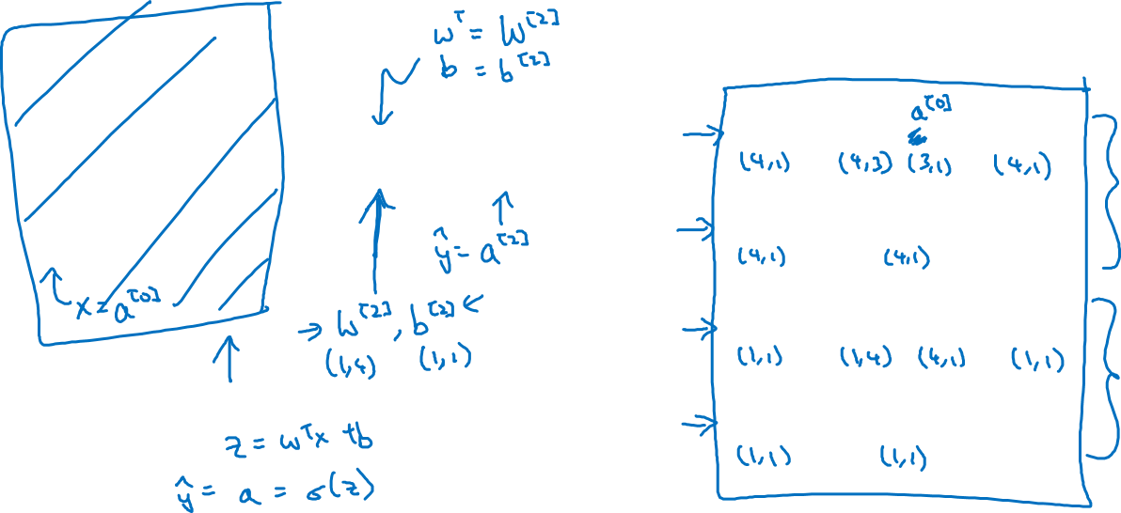

Neural Network Representation learning
$$a_{1}^{\left[1\right]}$$
Given input x:
$$x_{1}$$
$$a_{2}^{\left[1\right]}$$
$$z^{\left[1\right]}=W^{\left[1\right]}x+b^{\left[1\right]}$$
$$x_{2}$$
$$\hat{y}$$
$$a_{3}^{\left[1\right]}$$
$$x_{3}$$
$$a^{\left[1\right]}=σ(z^{\left[1\right]})$$
$$a_{4}^{\left[1\right]}$$
$$z^{\left[2\right]}=W^{\left[2\right]}a^{\left[1\right]}+b^{\left[2\right]}$$
$$a^{\left[2\right]}=σ(z^{\left[2\right]})$$
Notes:
The first layer operation got us Z 1, we applied operations to get us a1. Than we applied operations on a1 to get us z2 & a2.

